Slide 1
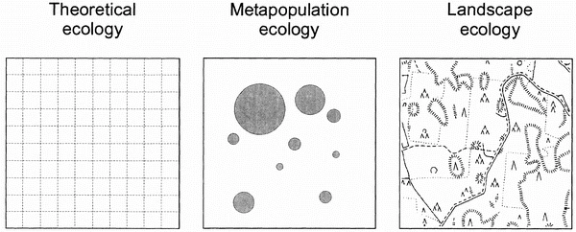
Population dynamics on discrete patches: metapopulations
Hanski 1998. Metapopulation dynamics. Nature 396: 41-49 https://www.nature.com/articles/23876

Slide 2
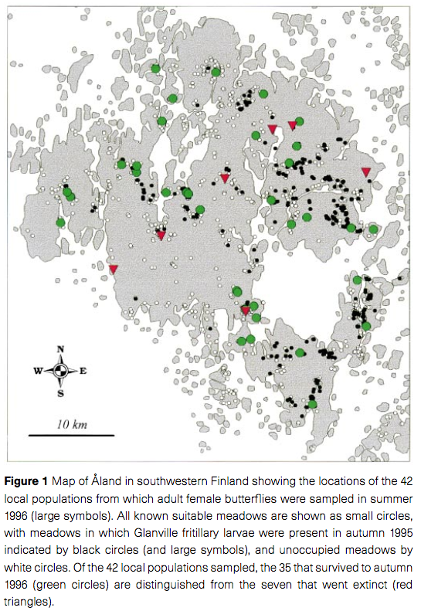
Saccheri et al. 1998. Nature 392: 491-494

Slide 3
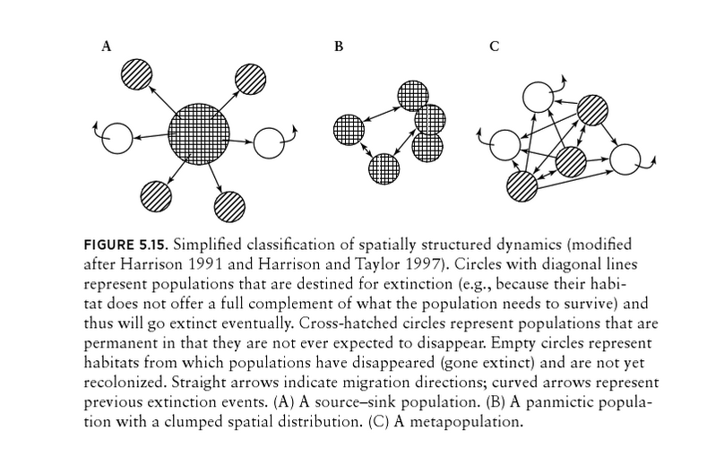

Slide 4
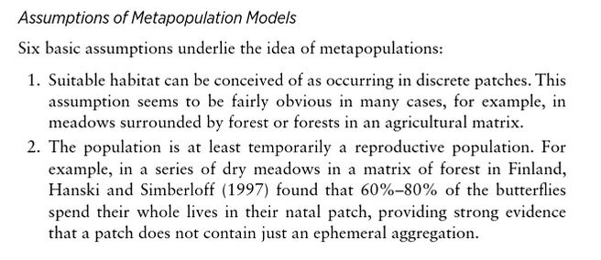

Slide 5
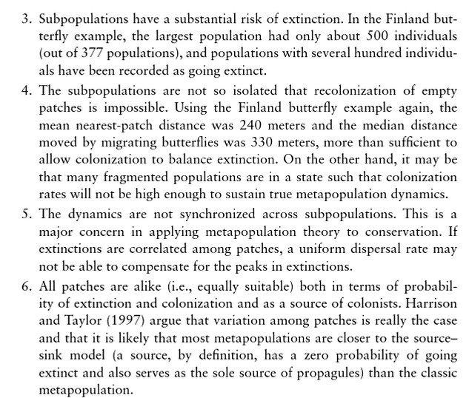

Slide 6

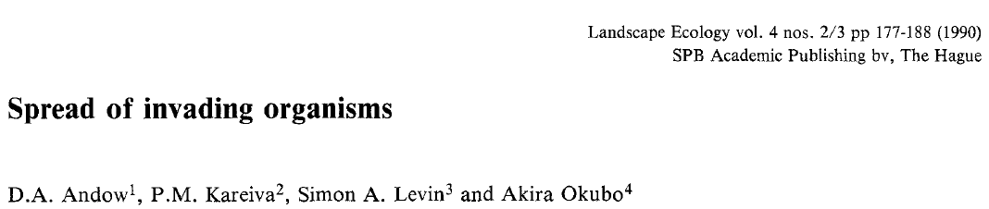
Population dynamics in continuous space
This reading is on the D2L

Slide 7
What do we need to know?
What do the terms in the reaction diffusion equation mean?
What are the variables and parameters?
What are the the assumptions of a reaction diffusion model for spatial population dynamics?
How are the parameters estimated?
What does the models predict?
How did the models perform when tested against data?

Slide 8
Reaction diffusion equation (2 dimensional space)
Reaction term
Diffusion term
Diffusion coefficient
Change in
population size, N, at a particular point in space (x,y)
Second partial derivatives of population size with respect to space (x and y): describe diffusive movement
A continuous time population growth function (i.e. exponential, logistic)

Slide 9
Reaction diffusion equation (2 dimensional space)
Variables
N(t,x,y): local population density (number per area) at time, t, at location (x,y)

Slide 10
Reaction diffusion equation (1 dimensional space, with f(N) as exponential growth)
Variables
N(t,x): local population density (number per area) at time, t, at location x.

Slide 11
Reaction diffusion equation (1 dimensional space, with f(N) as exponential growth)
Parameters
D: diffusion coefficient
α: intrinsic growth rate for the exponential model (i.e. α=r=b-d, where r is the notation typically used in class)

Slide 12
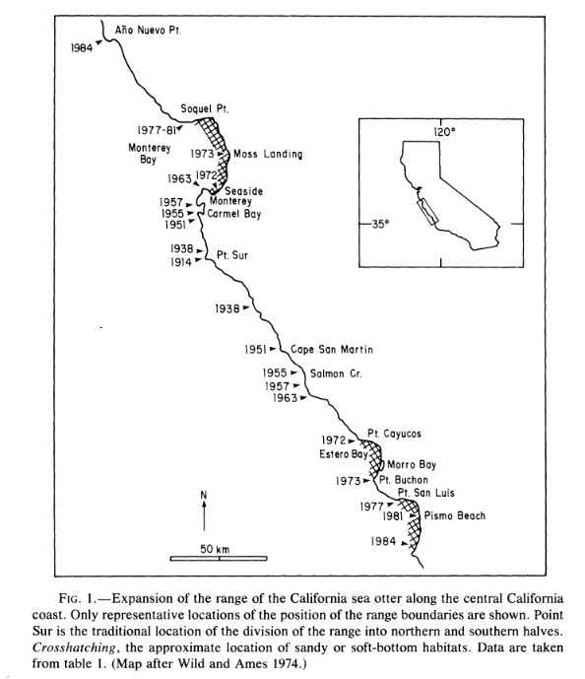

Can you think of an instance where 1 dimensional space would be appropriate?
Lubina and Levin 1988
Photo by Mike Baird bairdphotos.com

Slide 13
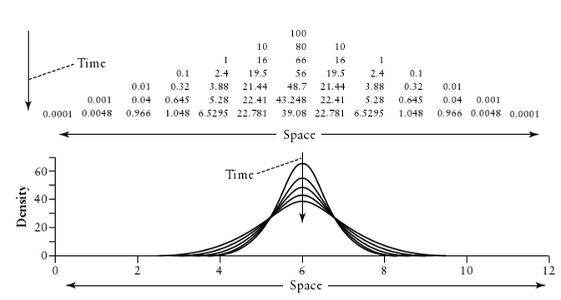
Assumptions of diffusive movement
Vandermeer and Goldberg. 2013. Figure 5.11 p139.

Slide 14
Assumptions of reaction-diffusion
At the population level, the dispersal distances follow a normal distribution
The assumptions regarding population growth are as the were for the non-spatial model
There is no relationship between movement and reproduction
Reproduction and dispersal parameters do not depend on spatial location
There is no defined order for reproduction and dispersal, both processes happen continuously

Slide 15
Estimating parameters
The parameters for the population growth model, f(N), can be estimates from data describing:
Population size over time (i.e. the Tribolium lab)
Birth and death rates (i.e., the Protection Island worksheet)

Slide 16
Estimating parameters
The diffusion coefficient, D, can be estimated if the mean dispersal distance, M_{D}(t), over a fixed period of time, t, is known:
(i.e. mark recapture, radiotelemetry)

Slide 17
What does reaction diffusion predict?
If f(N) is exponential or logistic growth then,
1 dimensional space: the range (length of habitat occupied by the species) increases linearly over time
2 dimensional space: divide space into sectors: distance from release point to a point on the boundary of the occupied habitat increases linearly over time

Slide 18
What does reaction diffusion predict?
If f(N) is exponential or logistic growth then,
The asymptotic rate of change in habitat occupied is

Slide 19
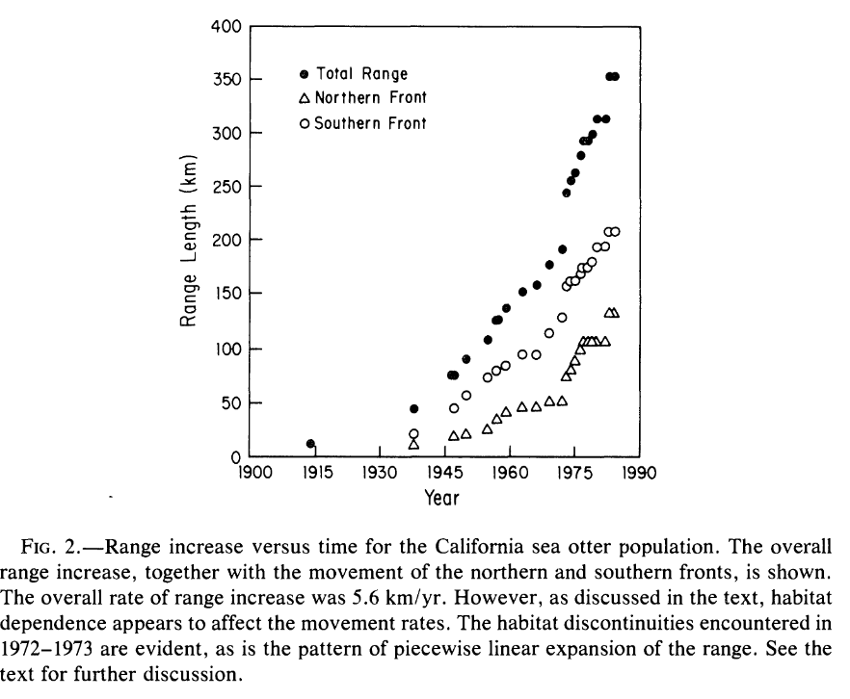
Lubina and Levin 1988

Slide 20
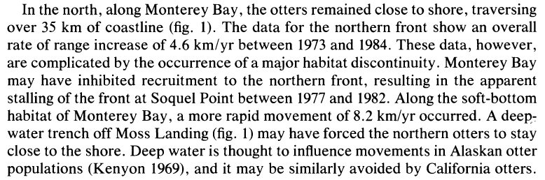
Habitat heterogeneity

Slide 21
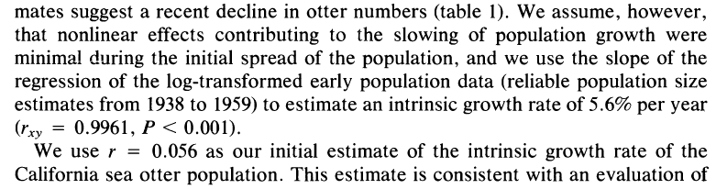
Estimation of r

Slide 22
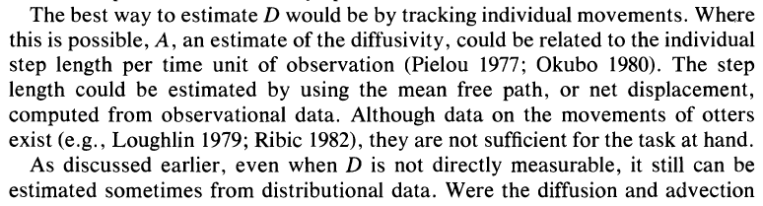
Estimation of D

Slide 23
 | α (yr⁻¹) | D (km²/yr) | V_{F} (km/yr)
Empirical data (combined N+S) | - | - | 5.6 9.4 (1973-84) 4.5 (1938-72)
Model predictions (combined N + S) | 0.056 | 104 | 4.8 2V_{F} = 9.6
Empirical data N | - | - | 1.4
Model predictions N | 0.056 | 13.5 | 1.74
Empirical data S | - | - | 3.1 (1938-72) 3.8 (1973-1980)
Model predictions S | 0.056 | 54.7 | 3.5
Lubina and Levin 1988

Slide 24
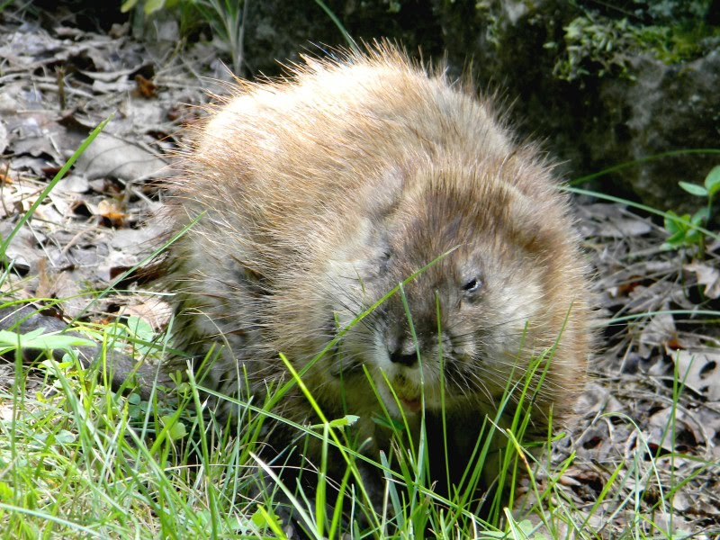
Photo by jumpingmaniac

Slide 25
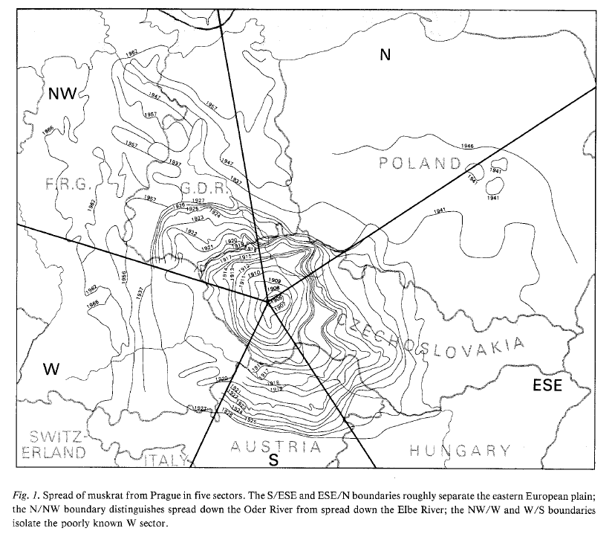
Why the sectors?

Slide 27
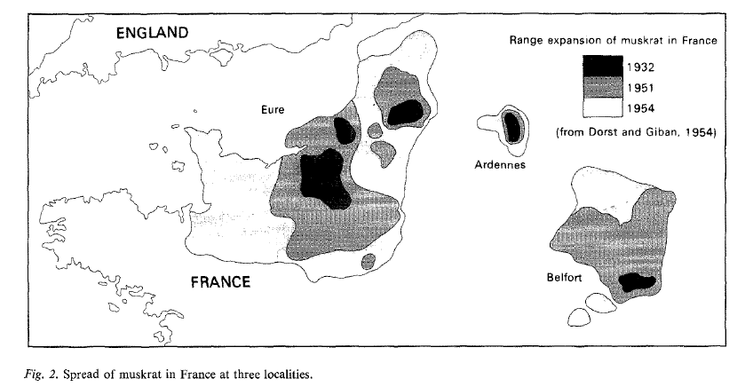

Slide 28
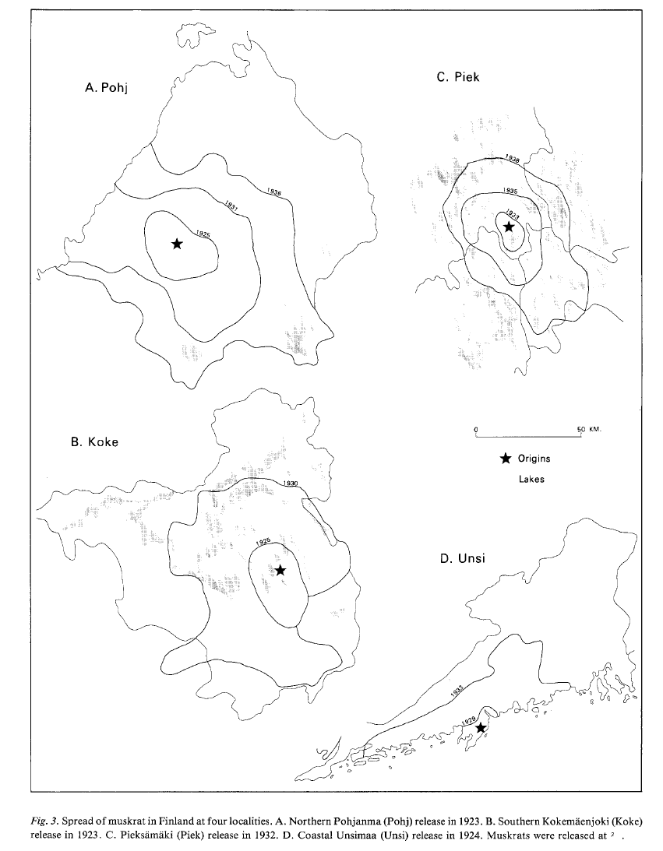

Slide 29
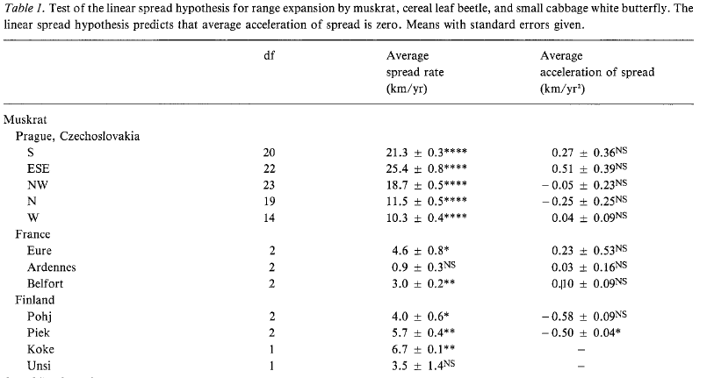
 | α (yr⁻¹) | D (km²/yr) | V_{F} (km/yr)
Predictions | 0.2-1.1 | 51 230.1 | 6-32

Slide 30
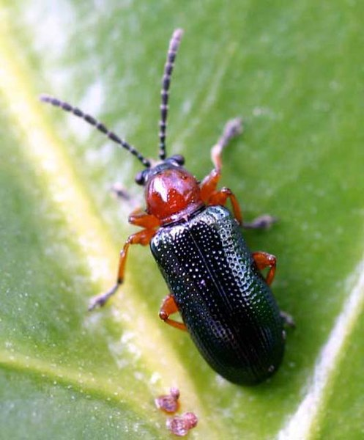
Source : http://home.tiscali.be/entomart.ins

Slide 31
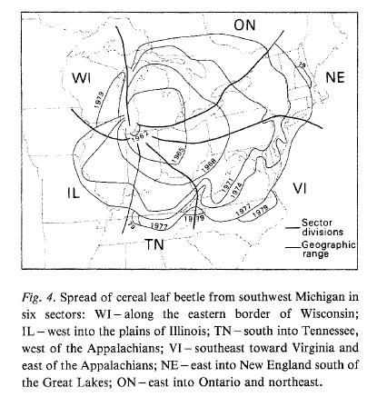

Slide 32
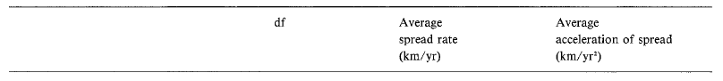
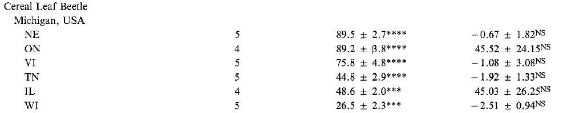
 | α (yr⁻¹) | D (km²/yr) | V_{F} (km/yr)
Predictions | 1.6-1.9 | 0.4 | 1.6-1.7
Failure to account for:
- long range movement on air currents
- hitchhiking on human transport

Slide 33

photo: JJ Harrison (jjharrison89@facebook.com

Slide 34
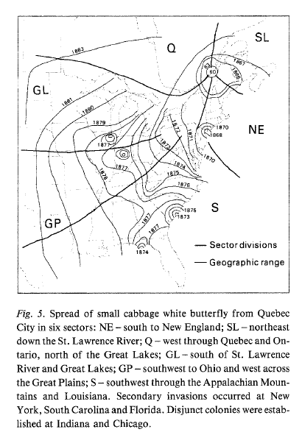

Slide 35
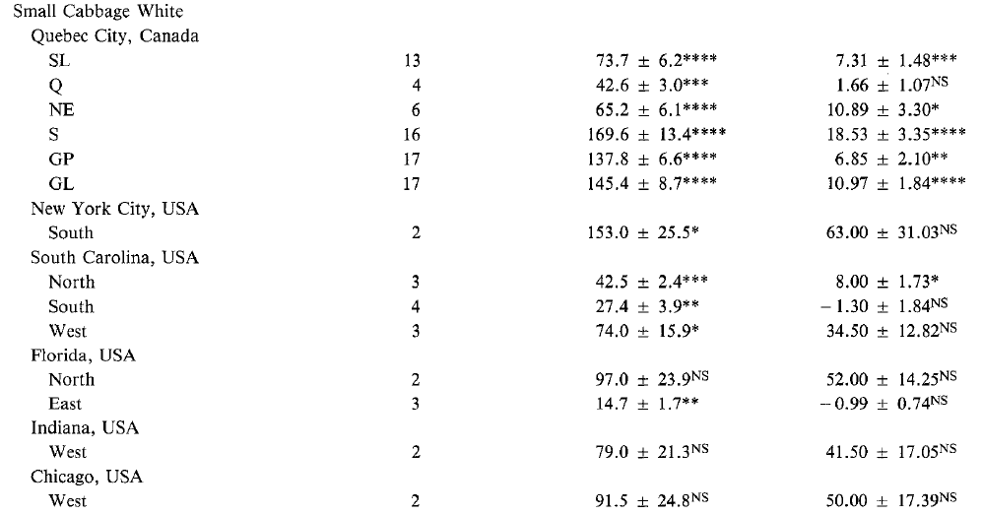
 | α (yr⁻¹) | D (km²/yr) | V_{F} (km/yr)
Predictions | 9 31.5 | 4.8 129 | 13-127

Slide 36
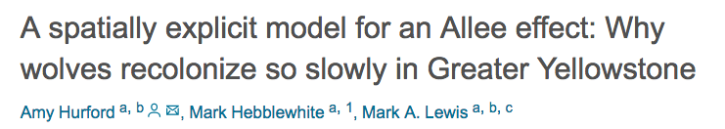

Slide 37
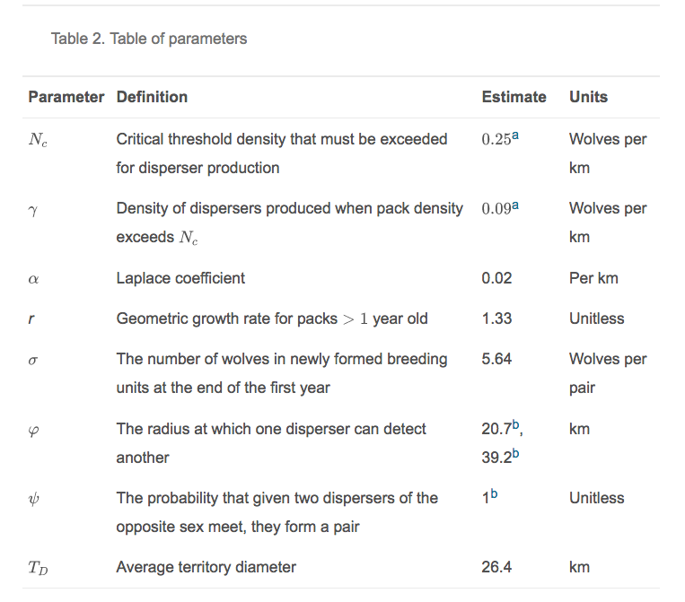

Slide 38
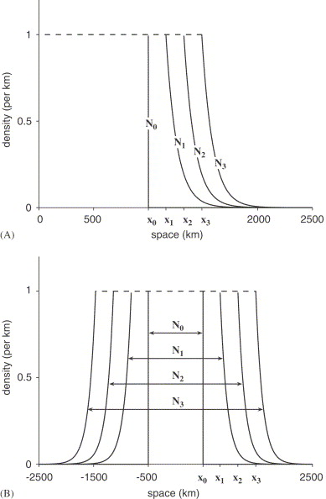

Slide 39
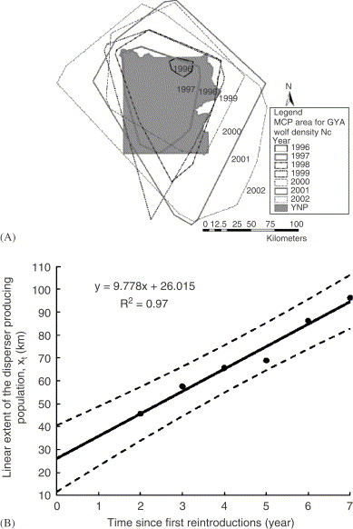

Slide 40
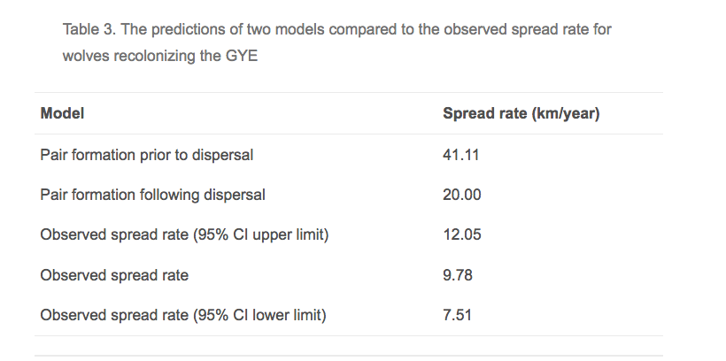

Slide 41
Summary
Reaction diffusion equations describe populations dynamics in a spatially continuous environment
Reaction diffusion equations make assumptions
Reaction diffusion equations predict that range increases linearly over time
Parameterized model predictions can be tested against empirical data

